Slide 1
Class Notes Tuesday 9/19

Slide 2
Outline for today:
Class logistics
Forecast competition results
GitHub review
Some notes on working with markdown
Check in and questions from last week
Python exercise
Intro to pandas

Slide 3
Logistics
Homework solutions and grades posted
Proposed new office hours:
Monday: 1:30-2:30 (Zoom)
Thursday: 10:00 – 11:00 (In person)
Forecasts due by 12 on Monday homework not due until the end of the day on Monday

Slide 4
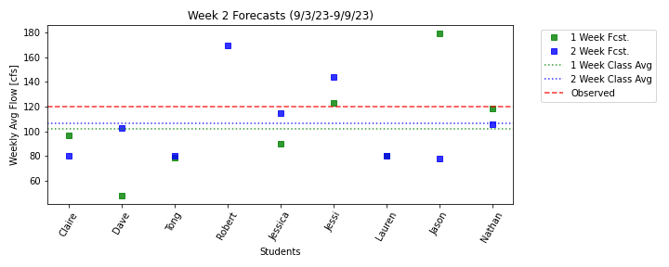
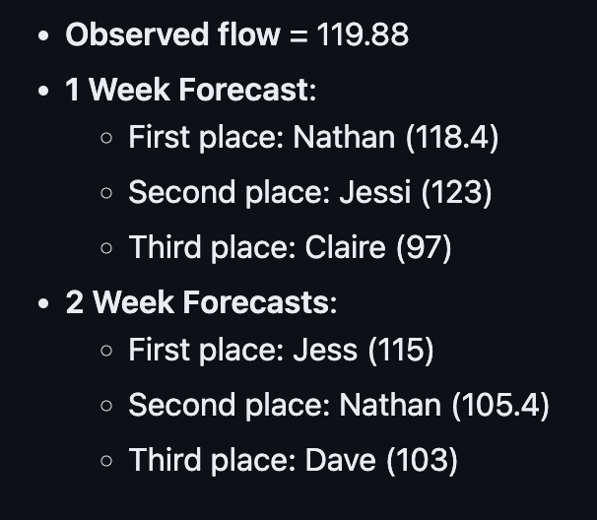
Forecast Results: 9/3-9/9

Slide 5
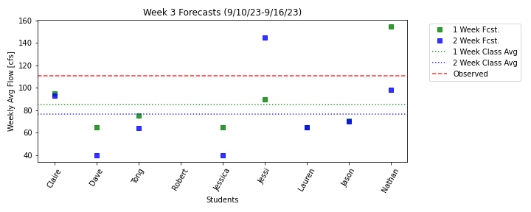
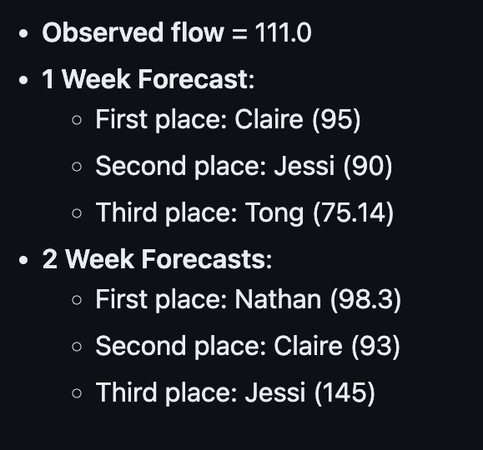
Forecast Results: 9/10-9/16

Slide 6
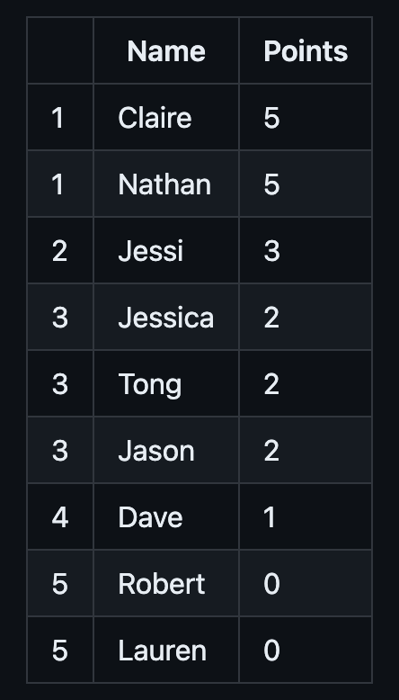
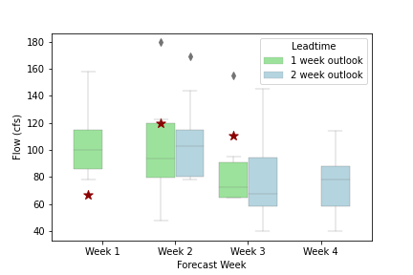
Overall performance so far

Slide 7
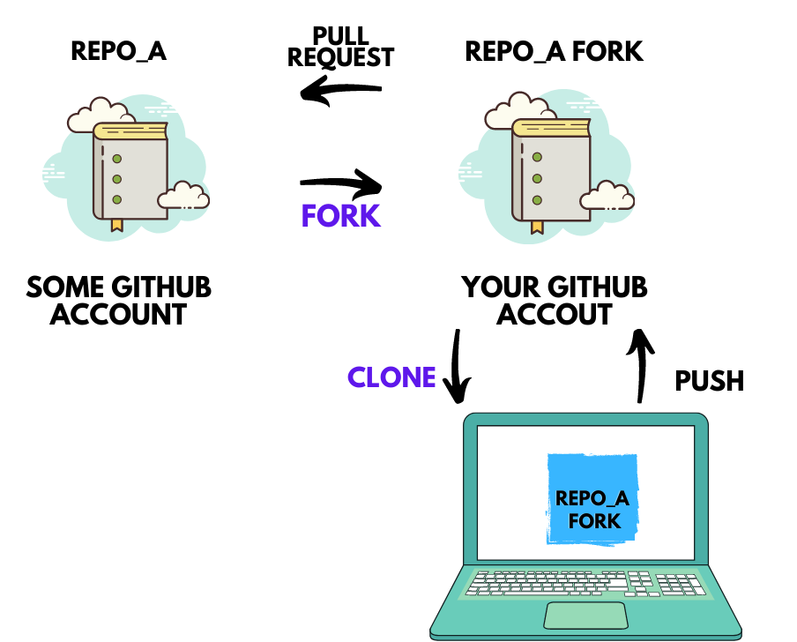
GitHub Review: What is the difference between Fork and Clone?
Fork is a copy that allows you to make your own changes without impact the original project
You are now pulling and pushing to your forked version of the repo not to the original repo.
To get information back to the original repo you need to do a pull request
Ideal if you want to use someone else’s code as a jumping off point to do your own thing
Image source: https://chedyhammami.medium.com/git-clone-vs-fork-in-github-610f158d61e3

Slide 8
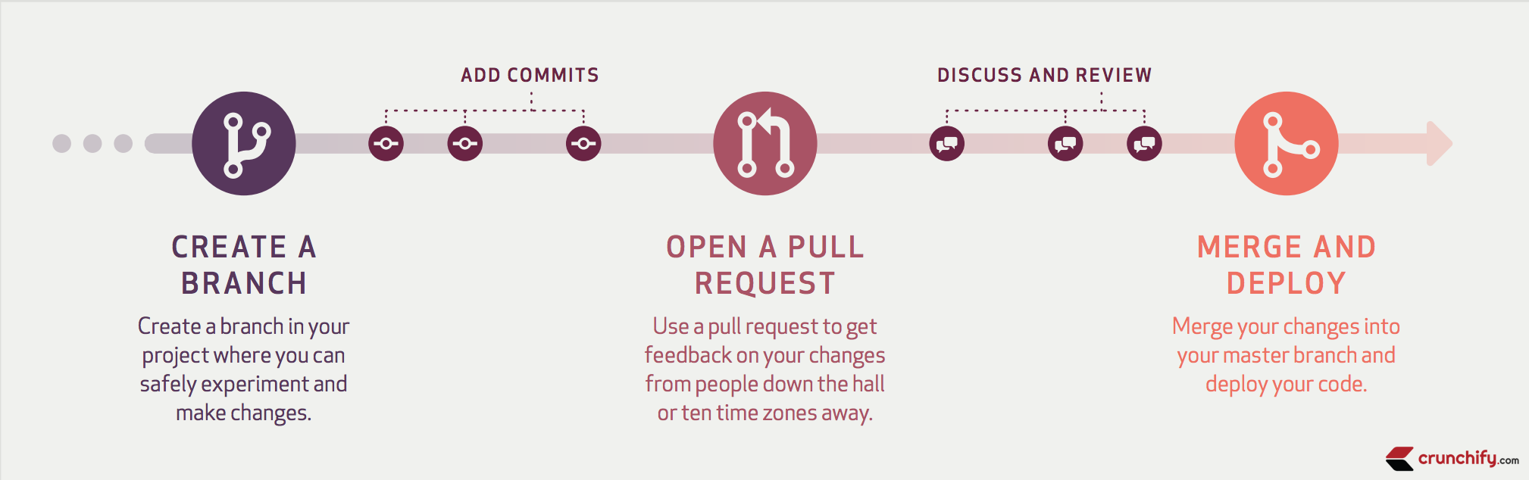
GitHub Review: What is the difference between pull request and pull?
When you ‘pull’ you are bringing changes from the remote to your local clone (i.e. pulling changes down).
Pull request is you requesting for the main branch to pull in some changes that you have pushed to your branch (this branch can be on a forked or a cloned version of the repo).
Image source: https://crunchify.com/how-to-fork-github-repository-create-pull-request-and-merge/

Slide 9
Markdown Skills: Preview and adding Images
Cntrl-shift-M (mac) to preview a markdown in vscode
Hold down shift to drag and drop an image into markdown
Or add the image manually like this:
![](myimage.png)
More markdown tricks can be found here

Slide 10
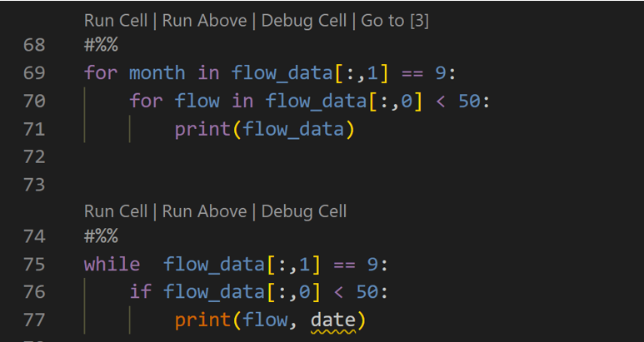
Questions from last week’s homework?

Slide 11
Exercises:
Exercise 1: Given two arrays a and b, create a new array that contains the maximum value at each index
a = np.array([5, 7, 9, 8, 6, 4, 5])
b = np.array([6, 3, 4, 8, 9, 7, 1])
Exercise 2: Use a while loop to print out the cumulative sum of the array c (i.e. the first nubmer, then the sum of the first 2 numbers, then the first 3 numbers etc.)

Slide 12
Intro to Pandas

